Slide 1

Gaming and Ideology:
The Power of Media (duh!)

Slide 2

This Just In: Media Affects Us.
You’d think it’d be common knowledge by now, but some people refuse to believe that the media affects us.
They sneer at media studies and then make extremely subjective statements like “I play violent video games and I’d never kill anyone! It’s all hogswash!”
I counter this mentality with three very simple examples. Here goes:

Slide 3


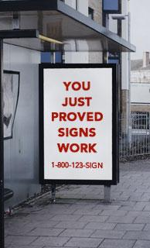
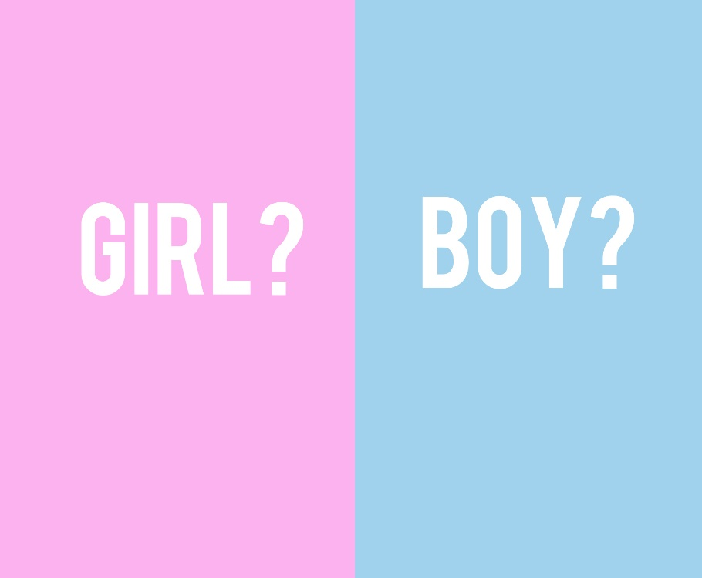
Why is French’s the #1 Mustard in North America?
Easy! Because the brand is recognizable and the label is pretty. The ingredients are exactly the same as any other off-brand (mustard seed, vinegar) and I dare you to taste the difference. Quite simply people buy French’s because it’s the “#1 Mustard in Canada” and thus continue the cycle. Weird, huh? In fact, who cares about French’s Mustard. Consider the ENTIRE MULTI-BILLION DOLLAR advertising industry and its power of creating wants, needs, desires, and REALITY via repeated exposure. Colours don’t have genders and yet consider how society has been brainwashed to associate blue with boys and pink with girls.

Slide 4

Why did you believe in Santa Clause?
Easy! Because people told you to: people you love and trust. Oh, and because you were repeatedly exposed to commercials, actors, images, videos, and television specials enforcing this idea. By age 8 my kids knew the laws of time, space and gravity pretty well. They know there’s no such thing as monsters, but they did believe an old man living in the north pole who makes toys for every kid in the world and then delivers them all in one night on his magic sleigh pulled by flying reindeer. (BTW—we could extend this whole analogy of belief to organized religion…but let’s not go there…). The point is this: repeated exposure equals brainwashing and a constructed reality.

Slide 5


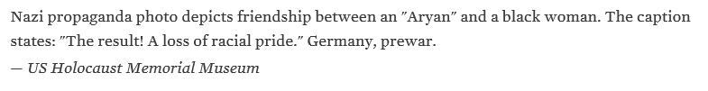
Why did Germans allow six million people to be rounded up, detained, starved, and then systematically killed?
Easy! Because they were repeatedly told by their country’s elected officials that non-whites were subhuman and the cause of all their problems. Oh, and they were repeatedly subjected to flyers, films, drawings, and other media propaganda enforcing this idea.

Slide 6
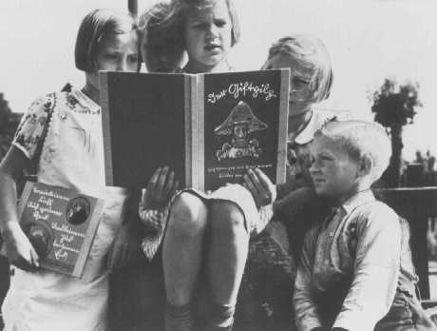
In fact…
Following the Nazi seizure of power in 1933, Hitler established a Reich Ministry of Public Enlightenment and Propaganda headed by Joseph Goebbels.
The Ministry's aim was to ensure that the Nazi message was successfully communicated through art, music, theater, films, books, radio, educational materials, and the press.
German children read an anti-Jewish propaganda book titled DER GIFTPILZ ( "The Poisonous Mushroom"). The girl on the left holds a companion volume, the translated title of which is "Trust No Fox." Germany, ca. 1938.

Slide 7
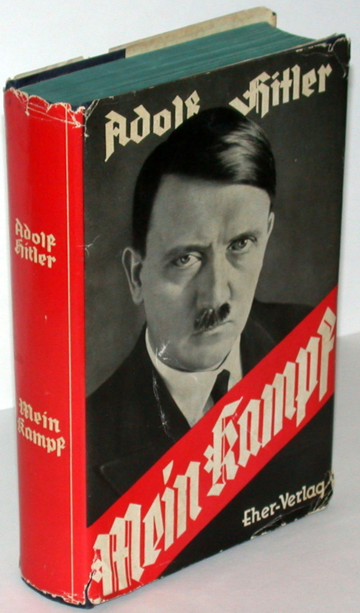
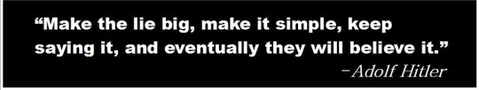
Hitler—so evil, yet so smart.
In his book Mein Kampf (“My Struggle”) Hitler enlightened his audience about the beauty of media propaganda:

Slide 8
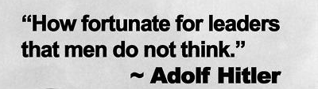
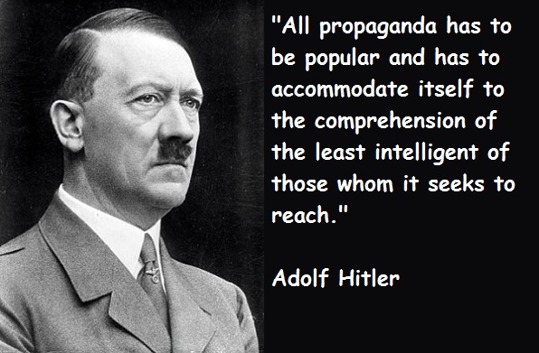
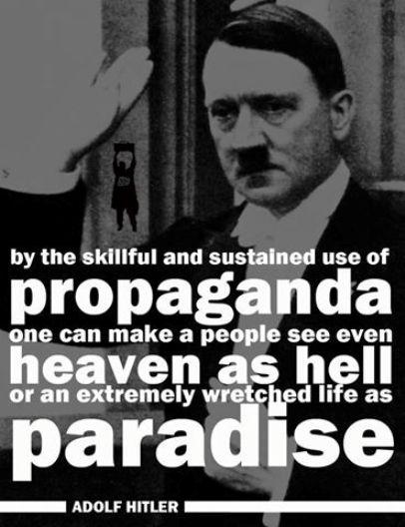
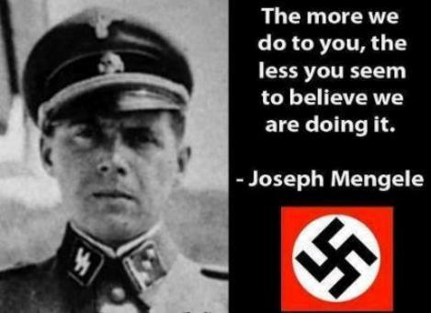
And so on, and so on…..

Slide 9
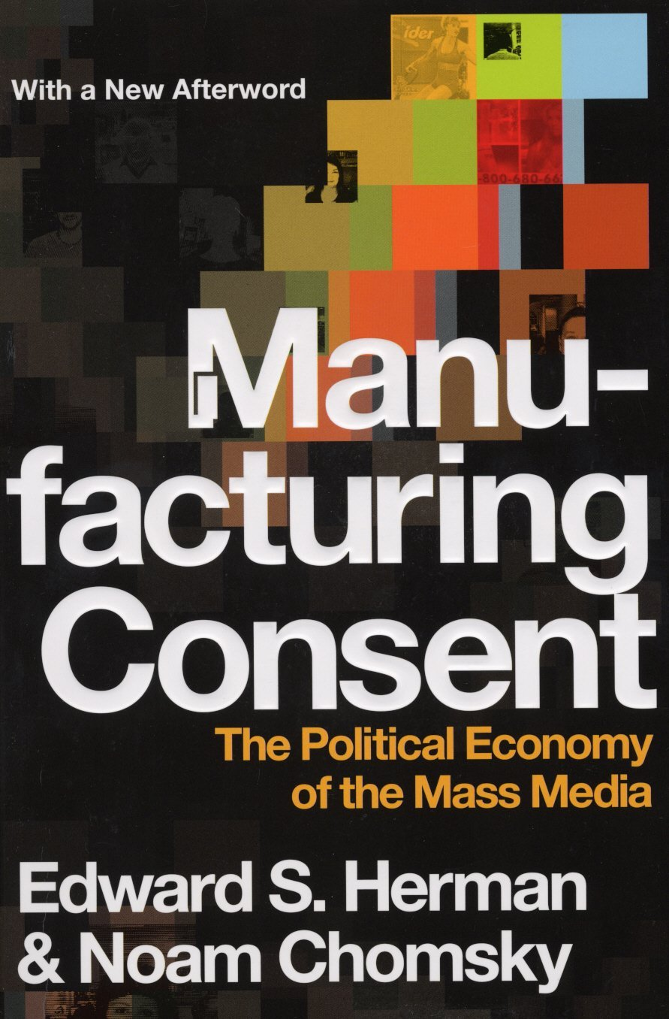


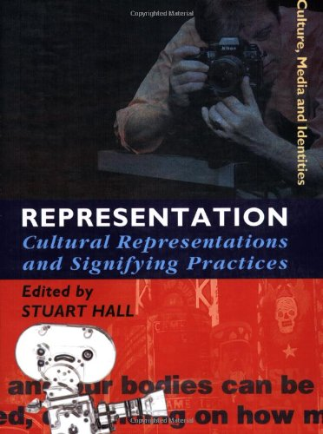
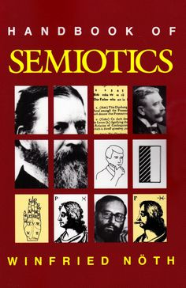
But Don’t Take My Word For It….
Media theorists have been around for decades publishing thoughtful academic literature on the power of words and images.
Do some digging on your own if you wish—don’t take some bozo’s youtube video or comment as the final word…you just look ignorant.

Slide 10
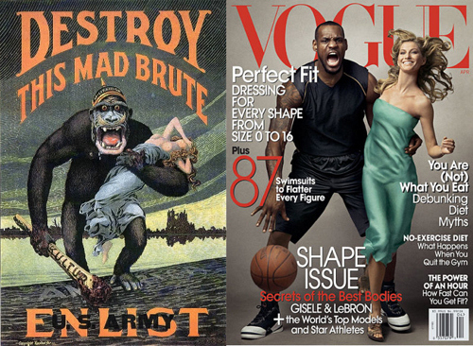
My point?
Media’s affects cannot be reduced to a 1:1 ratio of “I saw a woman as a waitress so now I think all women should be waitresses” or “I saw a black person on TV portray a thug, so now I believe all black people are thugs.”
The media reinforces, validates, and normalizes images and beliefs via repeated exposure: it’s a very sophisticated form of propaganda.

Slide 11
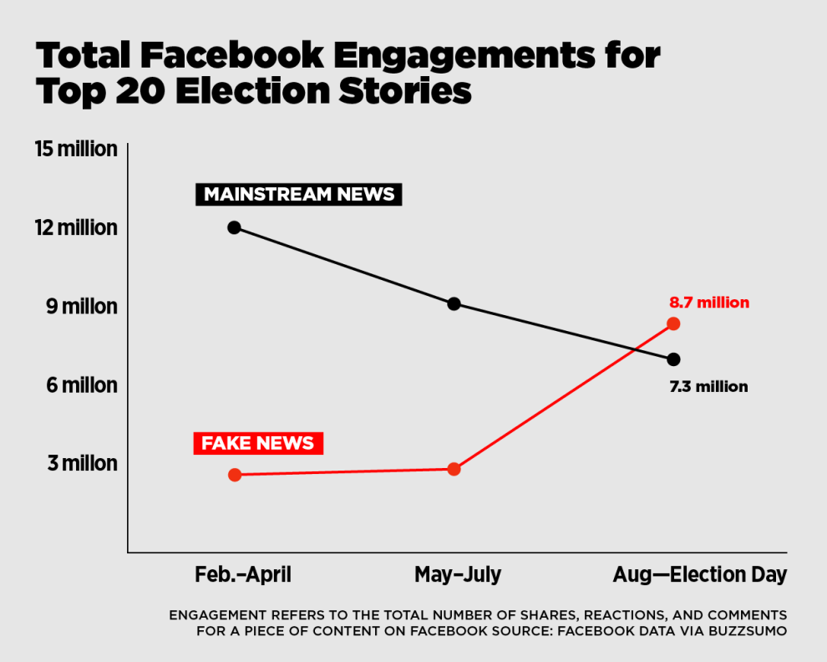
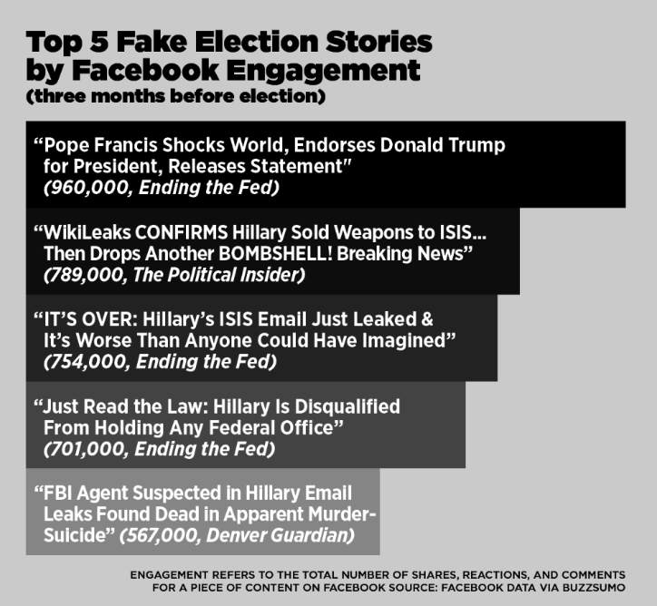
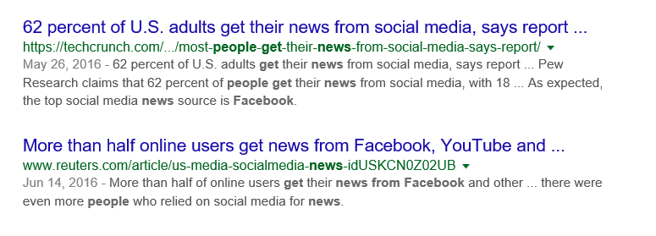
Consider Fake News and the US Election: Choose Your Own Reality

Slide 12
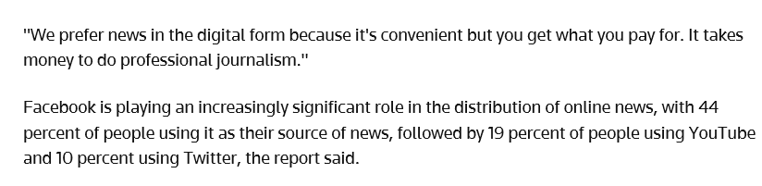
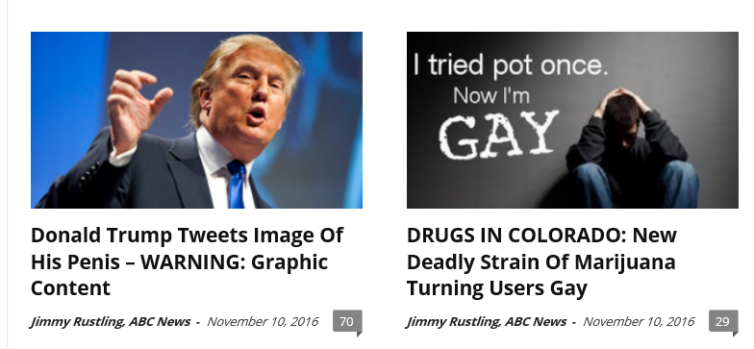
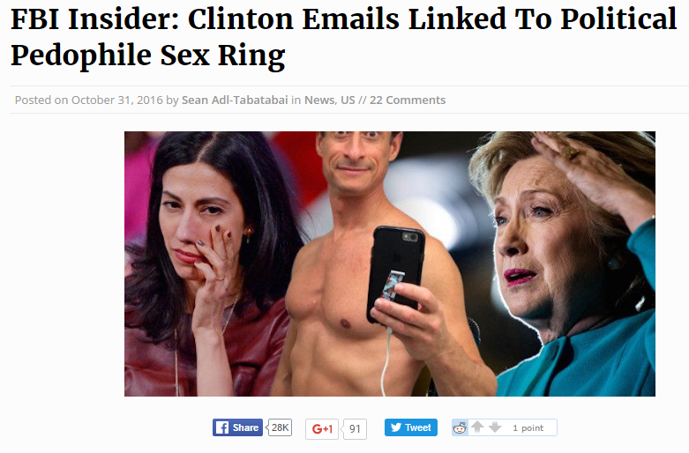
Are People Really This Dumb? The answer: yes.

Slide 13
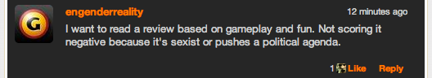
What the hell does any of this have to do with Video Games!!!??
Errant Signal - "Keep Your Politics Out of my Video Games" - YouTube
Media theory and analysis is accepted by fans of most major forms of media…all (it seems) except video games.
For whatever reason, when media analysis or any discussion of media representation or impact is brought on VGs, the VG community loses their shit (often fighting back in the most immature of ways—denial: “It’s just entertainment! Chill out!”)
But how can video games ever be taken seriously as an art form if they aren’t held to the same standards as film, literature, and music?

Slide 14
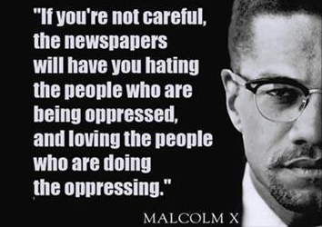
RE: SJWs
Never in my lifetime did I think fighting for social justice would be an insult.
Some call SJW’s “too emotional” and favouring “emotion over logic,” as if discrimination doesn’t exist and media plays no part.

Slide 15
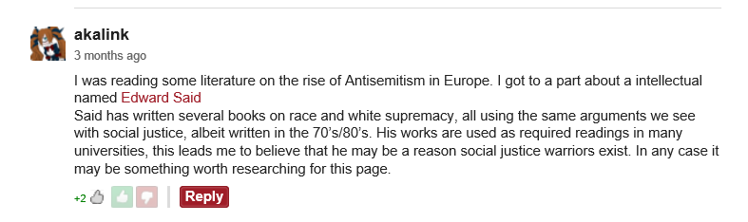
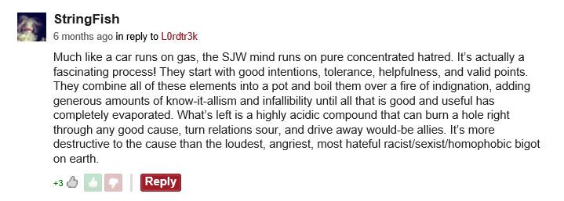
No shit guy—this stuff wasn’t invented with the internet…
Um, I guess (?)—yes, idiots can be both liberal and conservative. The REAL problem is how the SJW label is used by the VG community to dismiss ANYONE who even broaches this subject with a rational argument.

Slide 16
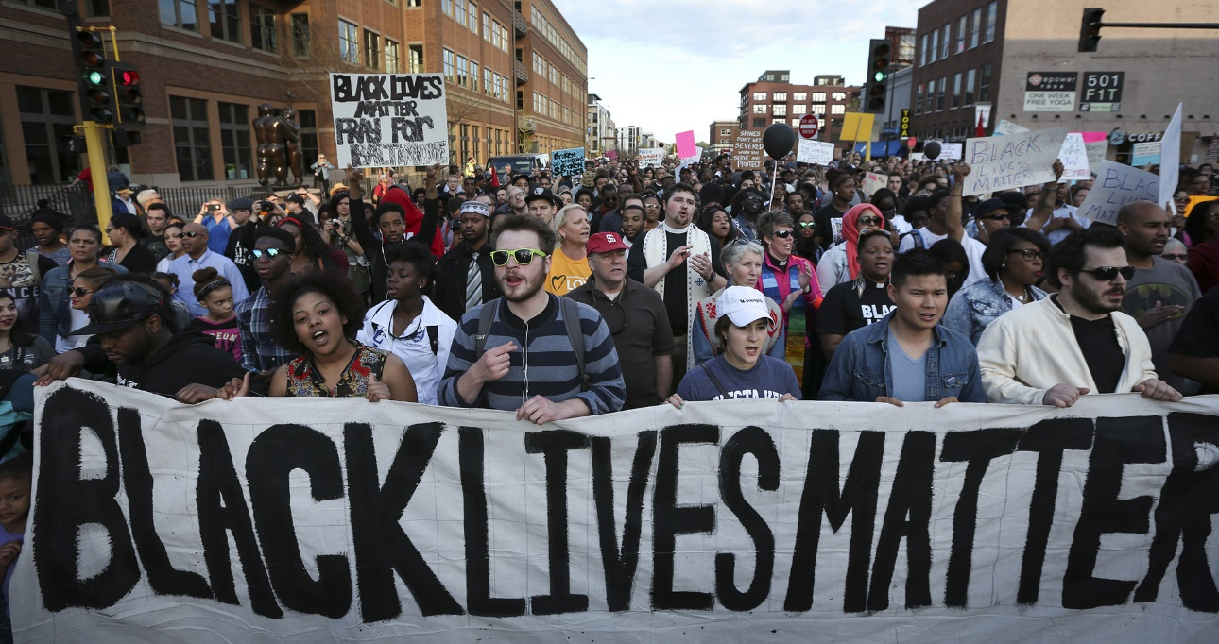
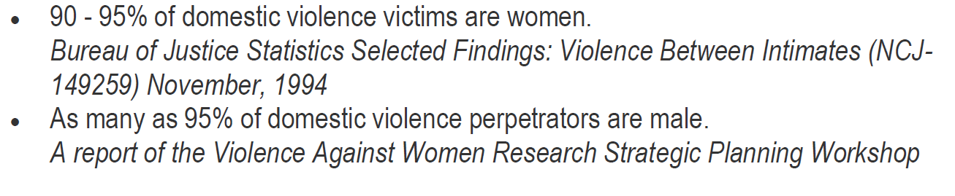
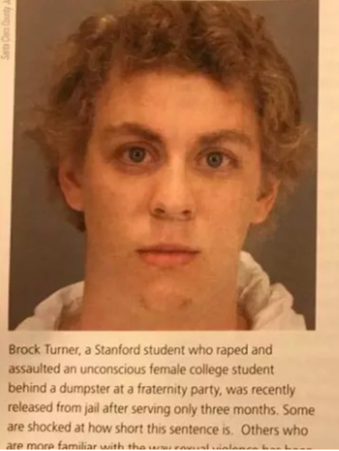

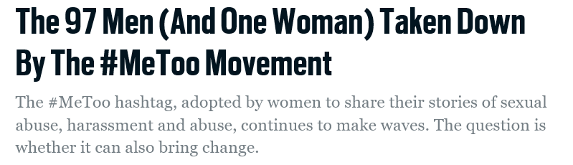
To repeat, video games (like all media) are not separate from (or outside of) the culture in which they exist….a culture where….

Slide 17
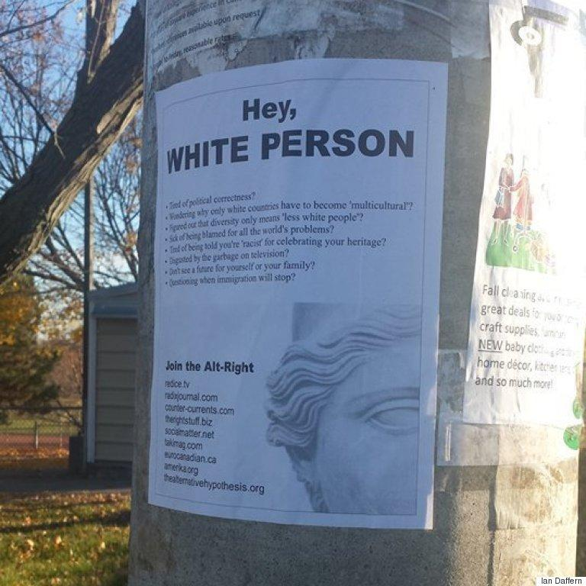
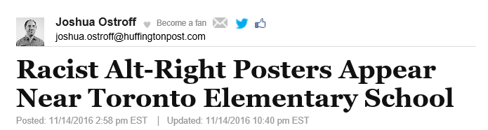


Slide 18
What Does This Mean For You As A Designer?
Really, it just means that the choices you make in designing your video games matter:
Politically (inclusive, exclusive, irresponsible, or offensive designs)
Artistically (originality or clichés)
Economically (funding and sales)
NOT CENSORSHIP but instead AWARENESS
Your games have MEANING and are not NEUTRAL (even if you want them to be)
Your games EXIST in the wider world—they are NOT separate from it.
Your games can CHALLENGE stereotypes or REINFORCE them
Your games can VALIDATE and NORMALIZE prejudicial attitudes or they can promote dignity, diversity, and acceptance.
Make whatever the hell game you wish, with whatever characters you wish, in whatever situations you wish. You are the artist. But know that your games affect the wider culture whether you want them to or not. It is naïve to assume otherwise.

Slide 19
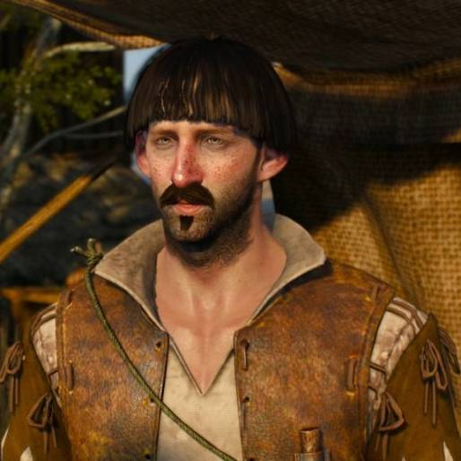
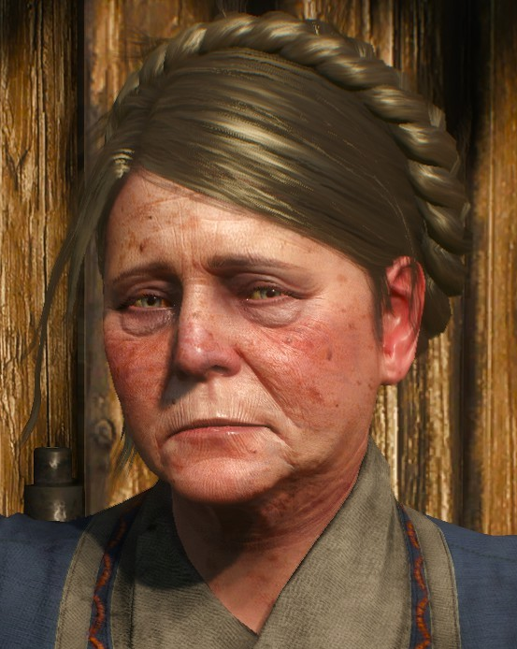
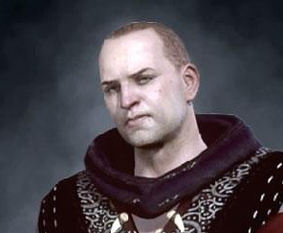
Regarding “reality” and Game Design
Often players and designers make excuses for (subtle and not so subtle) racist and sexist designs based on the defense that they have grounding in “reality.”
“But a women would do that in real life!”
“A black thug would say that in real life!”
This argument is a slippery-slope and completely falls apart under scrutiny
Video games are constructions—creations. Designers have complete control and are not held to the standards of “reality”
Consider special abilities, health, damage, plot…even in the most ‘realistic’ game these are COMPLETELY unreal!
Example: One player says “why are there only white characters in Witcher 3?” The other player says “because it’s in Northern Europe in the Medieval 1600s! Duh! You stupid SJW!” But, guess what, it’s a game about a “witcher”….hunting monsters…using magic. So, yeah. Not reality.

Slide 20
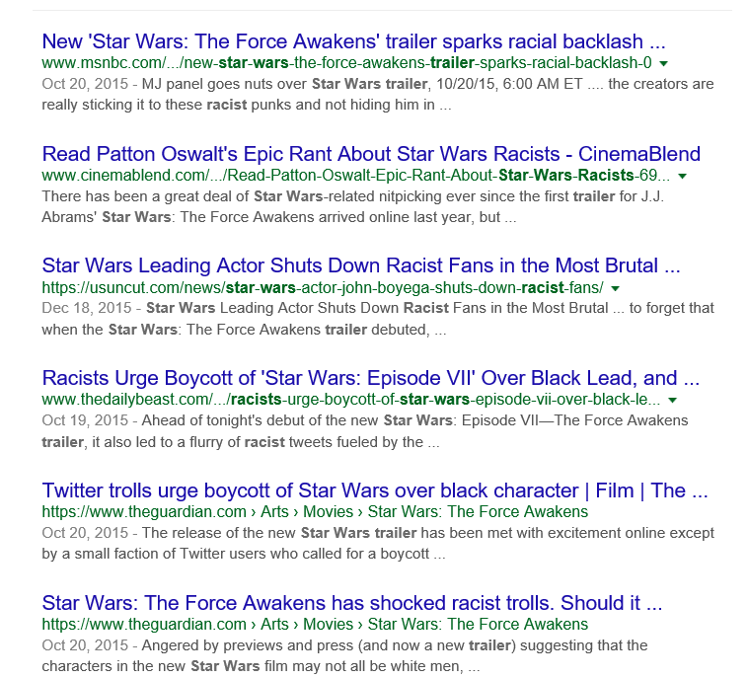
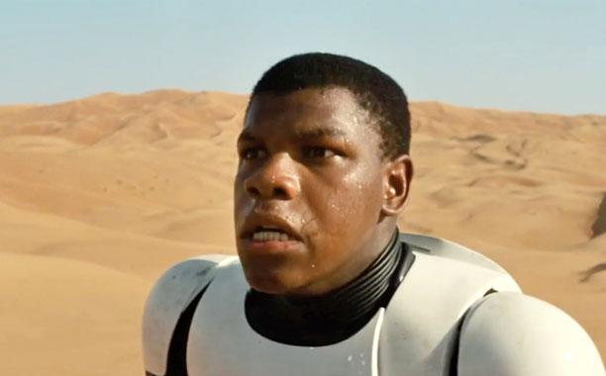
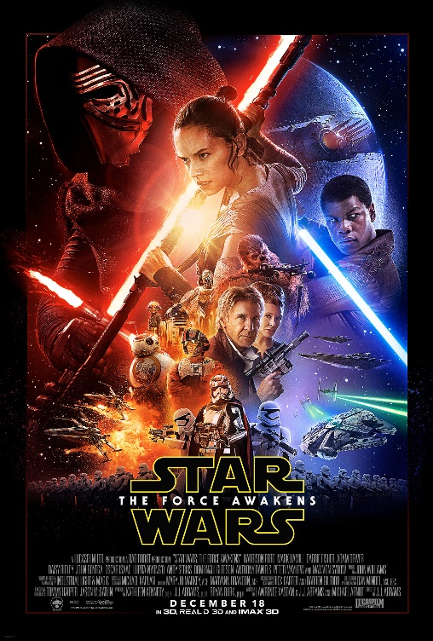

Slide 21
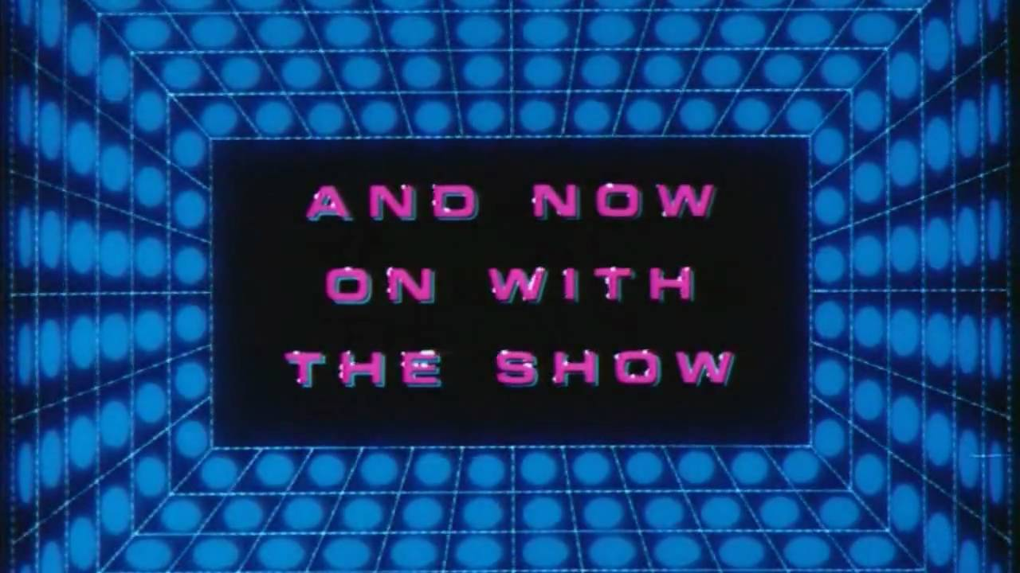
There are 3 types of student: the one who already knows media’s impact, the one who violently denies its impact, and the one who “just never thought of it before”: this lecture is most concerned with the last group.
And with that, let’s look at the (highly contentious) game design issues of race, gender, and violence (hopefully with an open mind).

